Slide 1
PHP Data Types

Slide 2
PHP Data Types
Variables can store data of different types, and different data types can do different things.
PHP supports the following data types:
String
Integer
Float (double)
Boolean
Array
Object
NULL

Slide 3
PHP String
A string is a sequence of characters, like "Hello world!".
A string can be any text inside quotes. You can use single or double quotes:
PHP Code
<?php $x = "Hello world!"; $y = 'Hello world!'; echo $x; echo "<br>"; echo $y; ?>

Slide 4
Continued..
Output:
Hello world! Hello world!

Slide 5
String Value with double qoute
The string value enclosed in double quote are automatically parsed for variable names.
<?php
$today= '10 DEC 1986';
$Name='Zaheer Ahmed';
echo "$Name Date of Birth $today";
?>

Slide 6
The PHP Concatenation Operator
There is only one string operator in PHP.
The concatenation operator (.) is used to join two string values together.
The example below shows how to concatenate two string variables together:
<?php $txt1="Hello world!"; $txt2="What a nice day!"; echo $txt1 . " " . $txt2; ?>
Out Put
Hello world! What a nice day!

Slide 7
PHP Integer
An integer is a whole number (without decimals). It is a number between -2,147,483,648 and +2,147,483,647.
Rules for integers:
An integer must have at least one digit (0-9)
An integer cannot contain comma or blanks
An integer must not have a decimal point
An integer can be either positive or negative

Slide 8
Example
In the following example $x is an integer. The PHP var_dump() function returns the data type and value:
<?php $x = 598; var_dump($x); ?>
Output
int(598)

Slide 9
PHP Float
A float (floating point number) is a number with a decimal point or a number in exponential form.
In the following example $x is a float. The PHP var_dump() function returns the data type and value:
<?php $x = 10.365; var_dump($x); ?>

Slide 10
Example
<?php $x = 10.365; var_dump($x); ?>
Output :
float(10.365)

Slide 11
PHP Boolean
A Boolean represents two possible states: TRUE or FALSE.
$x = true; $y = false;
Booleans are often used in conditional testing

Slide 12
PHP Operators
The assignment operator = is used to assign values to variables in PHP.
The arithmetic operator + is used to add values together in PHP.

Slide 13
Much Like Algebra
x=5 y=6 z=x+y
In algebra we use letters (like x) to hold values (like 5).
From the expression z=x+y above, we can calculate the value of z to be 11.
In PHP these letters are called variables.

Slide 14
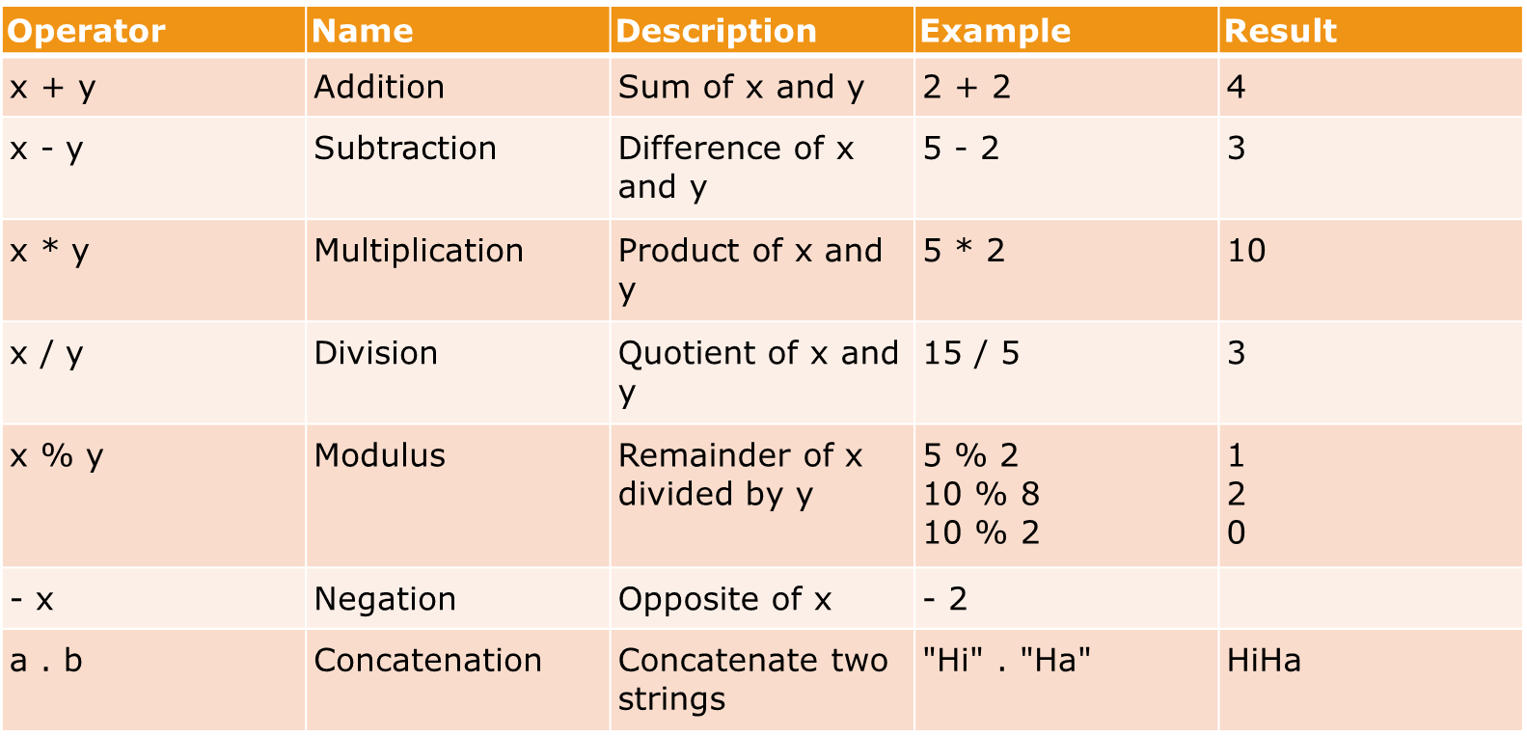
PHP Arithmetic Operators

Slide 15
PHP Assignment Operators
The basic assignment operator in PHP is "=". It means that the left operand gets set to the value of the expression on the right. That is, the value of "$x = 5" is 5.
Assignment | Same as... | Description
x = y | x = y | The left operand gets set to the value of the expression on the right
x += y | x = x + y | Addition
x -= y | x = x - y | Subtraction
x *= y | x = x * y | Multiplication
x /= y | x = x / y | Division
x %= y | x = x % y | Modulus
a .= b | a = a . b | Concatenate two strings

Slide 16
PHP Incrementing/Decrementing Operators
Operator | Name | Description
++ x | Pre-increment | Increments x by one, then returns x
x ++ | Post-increment | Returns x, then increments x by one
-- x | Pre-decrement | Decrements x by one, then returns x
x -- | Post-decrement | Returns x, then decrements x by one

Slide 17
PHP Comparison Operators
Comparison operators allows you to compare two values:
Operator | Name | Description | Example
x == y | Equal | True if x is equal to y | 5==8 returns false
x === y | Identical | True if x is equal to y, and they are of same type | 5==="5" returns false
x != y | Not equal | True if x is not equal to y | 5!=8 returns true
x <> y | Not equal | True if x is not equal to y | 5<>8 returns true
x !== y | Not identical | True if x is not equal to y, or they are not of same type | 5!=="5" returns true
x > y | Greater than | True if x is greater than y | 5>8 returns false
x < y | Less than | True if x is less than y | 5<8 returns true
x >= y | Greater than or equal to | True if x is greater than or equal to y | 5>=8 returns false
x <= y | Less than or equal to | True if x is less than or equal to y | 5<=8 returns true

Slide 18
PHP Logical Operators
Operator | Name | Description | Example
x and y | And | True if both x and y are true | x=6 y=3 (x < 10 and y > 1) returns true
x or y | Or | True if either or both x and y are true | x=6 y=3 (x==6 or y==5) returns true
x xor y | Xor | True if either x or y is true, but not both | x=6 y=3 (x==6 xor y==3) returns false
x && y | And | True if both x and y are true | x=6 y=3 (x < 10 && y > 1) returns true
x || y | Or | True if either or both x and y are true | x=6 y=3 (x==5 || y==5) returns false
! x | Not | True if x is not true | x=6 y=3 !(x==y) returns true

Slide 19
Class Task
For your second PHP exercise, echo the following statement to the browser:
“Twinkle, Twinkle little star.”
Next, create two variables, one for the word “Twinkle” and one for the word “star”. Echo the statement to the browser, this time substituting the variables for the relevant words. Change the value of each variable to whatever you like, and echo the statement a third time. Remember to include code to show your statements on different lines.

Slide 20

Task2
Write a e PHP script to display string, values within a table. Note : Use HTML table elements into echo. Expected Output :

